Slide 1



377 Operating Systems
Join on Zoom if you are remote (see Moodle for link).
Introduction to CPU Scheduling

Slide 2

Scheduling: Introduction
By now low-level mechanisms of running processes should be clear If not, go back a chapter or two and read it again, review course notes, etc.

Slide 3
Scheduling: Introduction
By now low-level mechanisms of running processes should be clear If not, go back a chapter or two and read it again, review course notes, etc.
However, we have yet to understand the high-level policies that an OS scheduler employs.

Slide 4
Scheduling: Introduction
By now low-level mechanisms of running processes should be clear If not, go back a chapter or two and read it again, review course notes, etc.
However, we have yet to understand the high-level policies that an OS scheduler employs.
We will now do just that, presenting a series of scheduling policies that various smart and hard-working people have developed over the years.

Slide 5
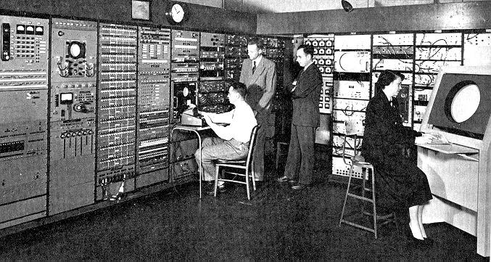
Scheduling: Origins
The origins of scheduling, in fact, predate computer systems; early approaches were taken from the field of operations management and applied to computers.

Slide 6
Scheduling: Origins
The origins of scheduling, in fact, predate computer systems; early approaches were taken from the field of operations management and applied to computers.
This reality should be no surprise: assembly lines and many other human endeavors also require scheduling, and many of the same concerns exist therein, including a laser-like desire for efficiency.

Slide 7
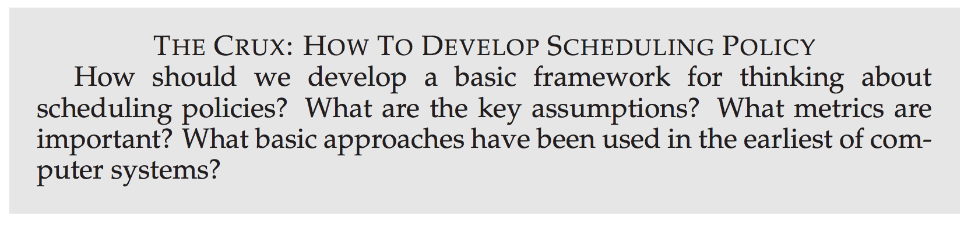

Slide 8
Workload Assumptions
First, we want to make some simplifying assumptions about running processes This is typically referred to as the workload.

Slide 9
Workload Assumptions
First, we want to make some simplifying assumptions about running processes This is typically referred to as the workload.
Simplified assumptions about running processes (often called jobs):

Slide 10
Workload Assumptions
First, we want to make some simplifying assumptions about running processes This is typically referred to as the workload.
Simplified assumptions about running processes (often called jobs):
Each job runs for the same amount of time

Slide 11
Workload Assumptions
First, we want to make some simplifying assumptions about running processes This is typically referred to as the workload.
Simplified assumptions about running processes (often called jobs):
Each job runs for the same amount of time
All jobs arrive at the same time

Slide 12
Workload Assumptions
First, we want to make some simplifying assumptions about running processes This is typically referred to as the workload.
Simplified assumptions about running processes (often called jobs):
Each job runs for the same amount of time
All jobs arrive at the same time
Once started, each job runs to completion

Slide 13
Workload Assumptions
First, we want to make some simplifying assumptions about running processes This is typically referred to as the workload.
Simplified assumptions about running processes (often called jobs):
Each job runs for the same amount of time
All jobs arrive at the same time
Once started, each job runs to completion
All jobs only use the CPU (i.e., no I/O)

Slide 14
Workload Assumptions
First, we want to make some simplifying assumptions about running processes This is typically referred to as the workload.
Simplified assumptions about running processes (often called jobs):
Each job runs for the same amount of time
All jobs arrive at the same time
Once started, each job runs to completion
All jobs only use the CPU (i.e., no I/O)
The run-time of each job is known

Slide 15
Workload Assumptions
First, we want to make some simplifying assumptions about running processes This is typically referred to as the workload.
Simplified assumptions about running processes (often called jobs):
Each job runs for the same amount of time
All jobs arrive at the same time
Once started, each job runs to completion
All jobs only use the CPU (i.e., no I/O)
The run-time of each job is known
Note, this is unrealistic and we will relax these as we go along.

Slide 16
Scheduling Metrics
Beyond making workload assumptions, we also need one more thing to enable us to compare different scheduling policies: a scheduling metric.
For now, however, let us also simplify our life by having a single metric:
turnaround time
Notes:
A metric is just something that we use to measure something, and there are a number of different metrics that make sense in scheduling.

Slide 17
Scheduling Metrics
Beyond making workload assumptions, we also need one more thing to enable us to compare different scheduling policies: a scheduling metric.
For now, however, let us also simplify our life by having a single metric:
turnaround time
The turnaround time of a job is defined as the time at which the job completes minus the time at which the job arrived in the system.
Notes:
A metric is just something that we use to measure something, and there are a number of different metrics that make sense in scheduling.

Slide 18
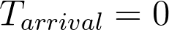
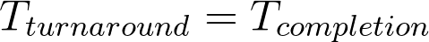
Scheduling Metrics
Because we have assumed that all jobs arrive at the same time, for now
and hence
This fact will change as we relax the aforementioned assumptions.
Notes:
A metric is just something that we use to measure something, and there are a number of different metrics that make sense in scheduling.

Slide 19
Scheduling Metrics
Because we have assumed that all jobs arrive at the same time, for now
and hence
This fact will change as we relax the aforementioned assumptions.
You should note that turnaround time is a performance metric, which will be our primary focus at the moment.
Notes:
A metric is just something that we use to measure something, and there are a number of different metrics that make sense in scheduling.

Slide 20
Scheduling Metrics
Because we have assumed that all jobs arrive at the same time, for now
and hence
This fact will change as we relax the aforementioned assumptions.
You should note that turnaround time is a performance metric, which will be our primary focus at the moment.
Another metric of interest is fairness.
Notes:
A metric is just something that we use to measure something, and there are a number of different metrics that make sense in scheduling.

Slide 21
Scheduling Metrics
Because we have assumed that all jobs arrive at the same time, for now
and hence
This fact will change as we relax the aforementioned assumptions.
You should note that turnaround time is a performance metric, which will be our primary focus at the moment.
Another metric of interest is fairness.
Performance and fairness are often at odds in scheduling
Notes:
A metric is just something that we use to measure something, and there are a number of different metrics that make sense in scheduling.

Slide 22
Scheduling Metrics
Because we have assumed that all jobs arrive at the same time, for now
and hence
This fact will change as we relax the aforementioned assumptions.
You should note that turnaround time is a performance metric, which will be our primary focus at the moment.
Another metric of interest is fairness.
Performance and fairness are often at odds in scheduling
A scheduler, for example, may optimize performance but at the cost of preventing a few jobs from running, thus decreasing fairness.
This conundrum shows us that life isn’t always perfect.
Notes:
A metric is just something that we use to measure something, and there are a number of different metrics that make sense in scheduling.

Slide 23
First In, First Out (FIFO)

Slide 24


First In, First Out (FIFO)
The most basic algorithm we can implement is known as First In, First Out (FIFO) scheduling or sometimes First Come, First Served (FCFS).
FIFO has a number of positive properties: it is clearly simple and thus easy to implement. And, given our assumptions, it works pretty well.

Slide 25
Example 1: First In, First Out (FIFO)
Imagine three jobs arrive in the system, A, B, and C, at roughly the same time (T_{arrival} = 0).
Because FIFO has to put some job first, let’s assume that while they all arrived simultaneously, A arrived just a hair before B which arrived just a hair before C.
Assume also that each job runs for 10 seconds.
What will the average turnaround time be for these jobs?

Slide 26
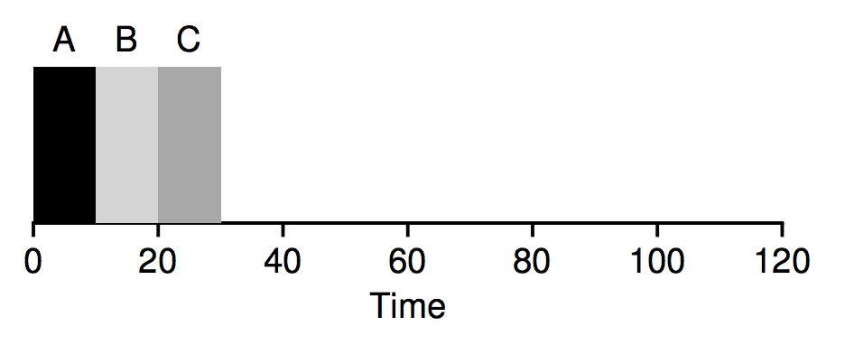
Example 1: First In, First Out (FIFO)
As you can see, A finished at 10, B at 20, and C at 30.
Thus, the average turnaround time is ???

Slide 27
Example 1: First In, First Out (FIFO)
As you can see, A finished at 10, B at 20, and C at 30.
Thus, the average turnaround time is (10+20+30) / 3 = 20.

Slide 28
Workload Assumptions
Simplified assumptions about running processes (often called jobs):
Each job runs for the same amount of time
All jobs arrive at the same time
Once started, each job runs to completion
All jobs only use the CPU (i.e., no I/O)
The run-time of each job is known
What if we relax one of our assumptions?
In particular, let’s relax assumption 1 no longer assume that each job runs for the same amount of time.

Slide 29
Example 1: First In, First Out (FIFO)
Now, we no longer assume that each job runs for the same amount of time.
How does FIFO perform now?
In particular, let’s again assume three jobs (A, B, and C), but this time A runs for 100 seconds while B and C run for 10 each. (arriving in that order, one slightly before the next)

Slide 30
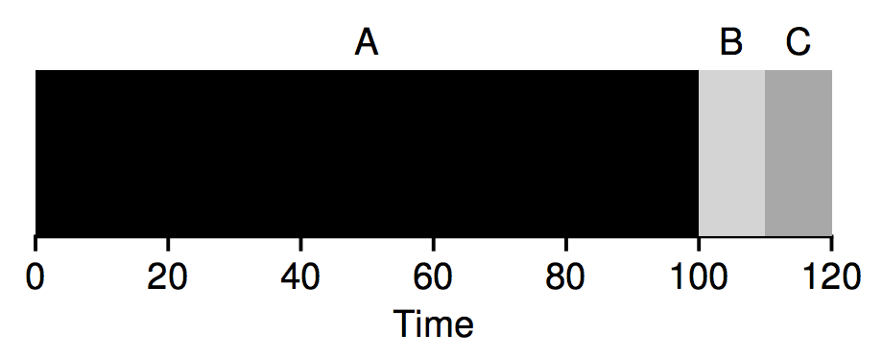
Question?
As you can see, A finished at 100, B at 110, and C at 120.
Thus, the average turnaround time is ???

Slide 31

Answer!
As you can see, A finished at 100, B at 110, and C at 120.
Thus, the average turnaround time is (100+110+120) / 3 = 110.

Slide 32
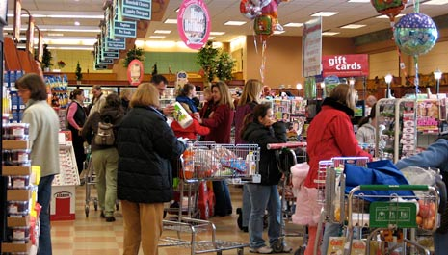
Convoy Effect
This problem is generally referred to as the convoy effect: A number of relatively-short potential consumers of a resource get queued behind a heavyweight resource consumer.
This scheduling scenario might remind you of a single line at a grocery store and what you feel like when you see the person in front of you with three carts full of provisions and a checkbook out; it’s going to be a while.

Slide 33

What can we easily do to fix this?

Slide 34
Shortest Job First

Slide 35
Example 1: Shortest Job First (SJF)
What if we applied SJF to our FIFO example from before?
What is the average turnaround time?

Slide 36
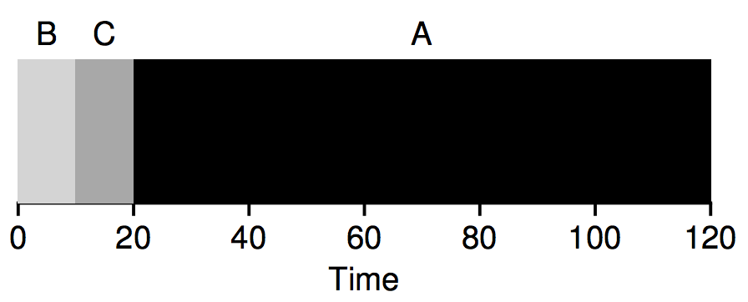
Example 1: Shortest Job First (SJF)
What if we applied SJF to our FIFO example from before?
What is the average turnaround time?
Thus, the average turnaround time is ???

Slide 37

Example 1: Shortest Job First (SJF)
~50% faster!
What if we applied SJF to our FIFO example from before?
What is the average turnaround time?
Thus, the average turnaround time is (10+20+120) / 3 = 50.

Slide 38
Workload Assumptions
Simplified assumptions about running processes (often called jobs):
Each job runs for the same amount of time
All jobs arrive at the same time
Once started, each job runs to completion
All jobs only use the CPU (i.e., no I/O)
The run-time of each job is known
Thus we arrive upon a good approach to scheduling with SJF
But our assumptions are still fairly unrealistic.
Let’s relax another.
In particular, we can target assumption 2, and now assume that jobs can arrive at any time instead of all at once.

Slide 39
Shortest Job First (SJF): Assumptions
So, now assume that jobs can arrive at any time instead of all at once.
What problems does this lead to?

Slide 40
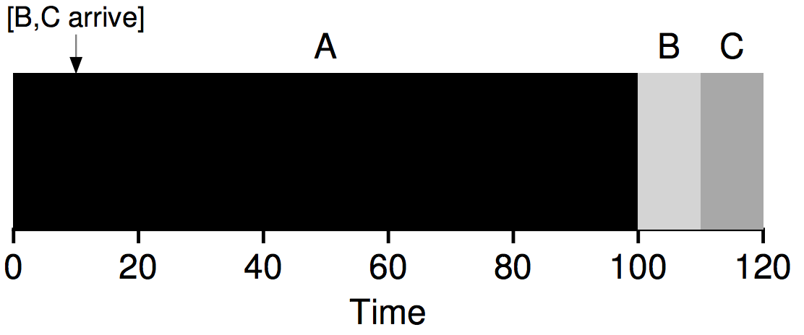
Shortest Job First Problem
As you can see from the figure, even though B and C arrived shortly after A, they still are forced to wait until A has completed, and thus suffer the same convoy problem. Average turnaround time for these three jobs is 103.33 seconds.

Slide 41
What can we easily do to fix this?

Slide 42
Shortest Time to Completion First

Slide 43
Workload Assumptions
Simplified assumptions about running processes (often called jobs):
Each job runs for the same amount of time
All jobs arrive at the same time
Once started, each job runs to completion
All jobs only use the CPU (i.e., no I/O)
The run-time of each job is known
To address this concern, we need to relax assumption 3 (that jobs must run to completion).
We also need some machinery within the scheduler itself.

Slide 44
Shortest Time to Completion First (STCF)
As you might have guessed, given our previous discussion about timer interrupts and context switching, the scheduler can certainly do something else when B and C arrive:
it can preempt job A and decide to run another job, maybe continuing A later.
SJF by our definition is a non-preemptive scheduler, and thus suffers from the problems we just witnessed.

Slide 45
STCF Example #1
Fortunately, there is a scheduler which does exactly that: Add preemption to SJF, known as the Shortest Time-to-Completion First (STCF) or Preemptive Shortest Job First (PSJF) scheduler.
Any time a new job enters the system:
STCF scheduler determines which of the remaining jobs (including the new job) has the least time left
STCF schedules the shortest job first.

Slide 46
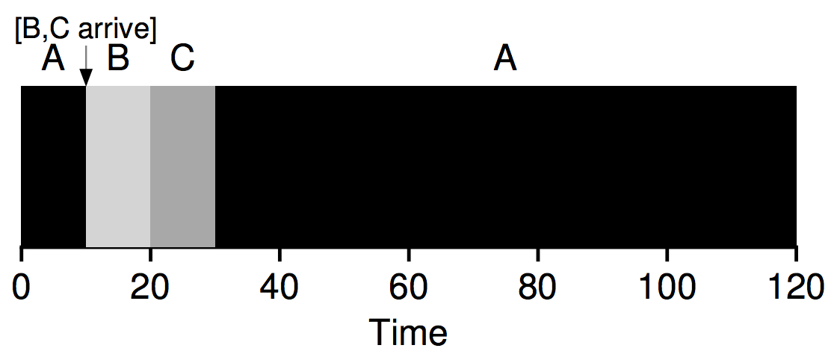
STCF Example #1
Thus, in our example, STCF would preempt A and run B and C to completion; only when they are finished would A’s remaining time be scheduled.

Slide 47
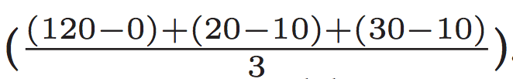
STCF Example #1
The result is a much-improved average turnaround time: 50 seconds
Given our new assumptions, STCF is provably optimal; given that SJF is optimal if all jobs arrive at the same time, you should probably be able to see the intuition behind the optimality of STCF.

Slide 48
A New Metric: Response Time
Thus, if we knew job lengths, and that jobs only used the CPU, and our only metric was turnaround time, STCF would be a great policy.

Slide 49
A New Metric: Response Time
Thus, if we knew job lengths, and that jobs only used the CPU, and our only metric was turnaround time, STCF would be a great policy.
In fact, for a number of early batch computing systems, these types of scheduling algorithms made some sense.

Slide 50
A New Metric: Response Time
Thus, if we knew job lengths, and that jobs only used the CPU, and our only metric was turnaround time, STCF would be a great policy.
In fact, for a number of early batch computing systems, these types of scheduling algorithms made some sense.
However, the introduction of time-shared machines changed all that. Now users would sit at a terminal and demand interactive performance from the system as well.

Slide 51
A New Metric: Response Time
Thus, if we knew job lengths, and that jobs only used the CPU, and our only metric was turnaround time, STCF would be a great policy.
In fact, for a number of early batch computing systems, these types of scheduling algorithms made some sense.
However, the introduction of time-shared machines changed all that. Now users would sit at a terminal and demand interactive performance from the system as well.
And thus, a new metric was born: response time

Slide 52
Response Time Definition
Response time is defined as the time from when the job arrives in a system to the first time it is scheduled. More formally:

Slide 53
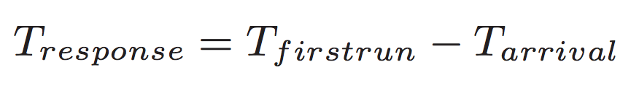
Response Time Definition
Response time is defined as the time from when the job arrives in a system to the first time it is scheduled. More formally:

Slide 54
Response Time Definition
Response time is defined as the time from when the job arrives in a system to the first time it is scheduled. More formally:
For example, if we had the previous schedule (with A arriving at time 0, and B and C at time 10), the response time of each job is as follows: 0 for job A, 0 for B, and 10 for C (average: 3.33).
((0 - 0) + (10 - 10) + (20 - 10)) / 3 = 3.33

Slide 55
STCF Response Time: Not so good :-(
As you might be thinking, STCF and related disciplines are not particularly good for response time.

Slide 56
STCF Response Time: Not so good :-(
As you might be thinking, STCF and related disciplines are not particularly good for response time.
If three jobs arrive at the same time, for example, the third job has to wait for the previous two jobs to run in their entirety before being scheduled just once.

Slide 57
STCF Response Time: Not so good :-(
As you might be thinking, STCF and related disciplines are not particularly good for response time.
If three jobs arrive at the same time, for example, the third job has to wait for the previous two jobs to run in their entirety before being scheduled just once.
While great for turnaround time, this approach is quite bad for response time and interactivity.
Indeed, imagine sitting at a terminal, typing, and having to wait 10 seconds…

Slide 58
STCF Response Time: Not so good :-(
As you might be thinking, STCF and related disciplines are not particularly good for response time.
If three jobs arrive at the same time, for example, the third job has to wait for the previous two jobs to run in their entirety before being scheduled just once.
While great for turnaround time, this approach is quite bad for response time and interactivity.
Indeed, imagine sitting at a terminal, typing, and having to wait 10 seconds…
Thus, we are left with another problem: how can we build a scheduler that is sensitive to response time?

Slide 59
What can we easily do to fix this?

Slide 60
Round Robin

Slide 61

Round Robin
The basic idea is simple:
Instead of running jobs to completion,
RR runs a job for a time slice (sometimes called a scheduling quantum),
then switches to the next job in the run queue.

Slide 62
Round Robin
To understand RR in more detail, let’s look at an example. Assume three jobs A, B, and C arrive at the same time in the system, and that they each wish to run for 5 seconds.

Slide 63
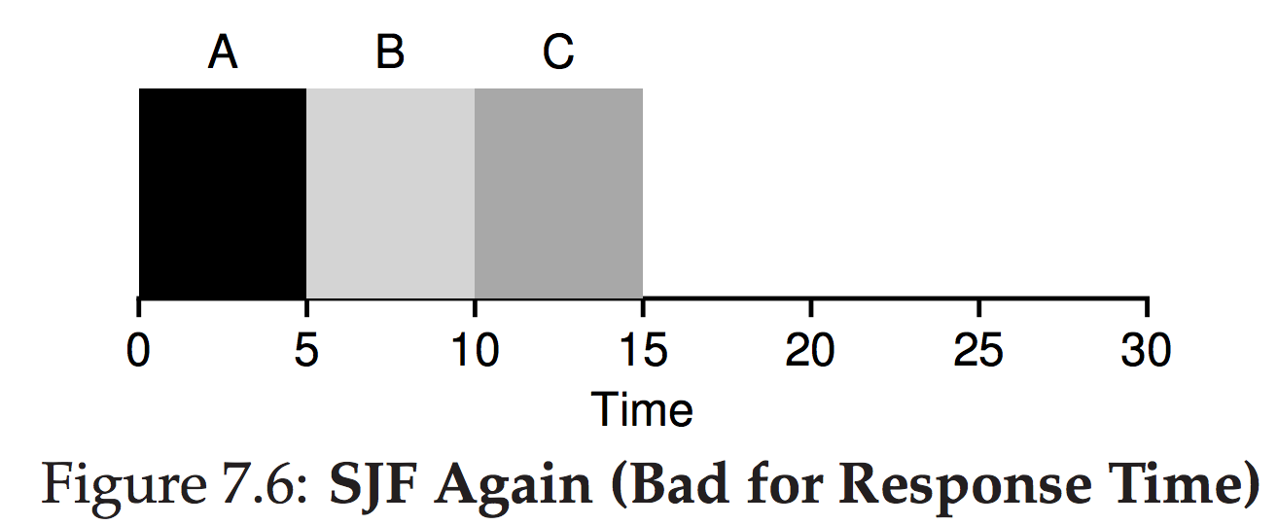
Round Robin
To understand RR in more detail, let’s look at an example. Assume three jobs A, B, and C arrive at the same time in the system, and that they each wish to run for 5 seconds.
An SJF scheduler runs each job to completion before running another.

Slide 64
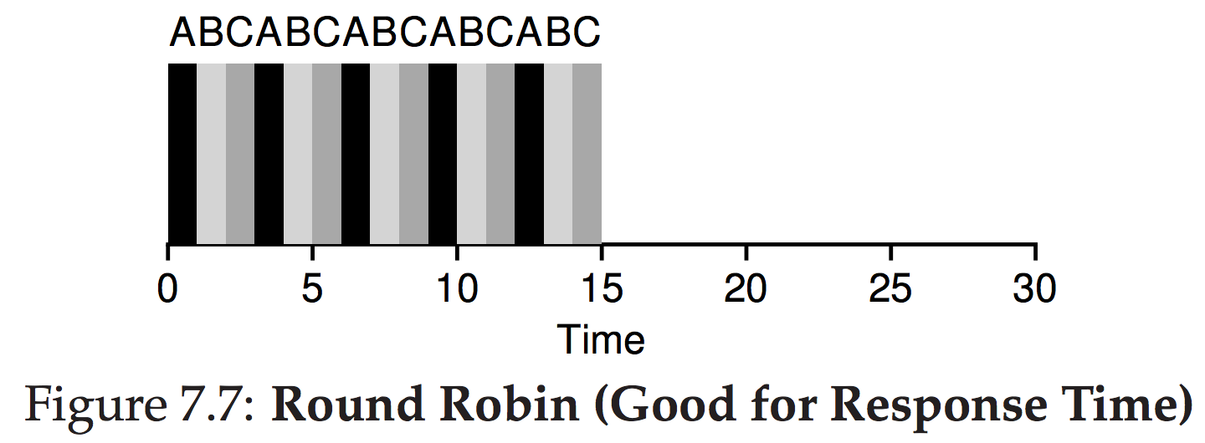
Round Robin
To understand RR in more detail, let’s look at an example. Assume three jobs A, B, and C arrive at the same time in the system, and that they each wish to run for 5 seconds.
An SJF scheduler runs each job to completion before running another.
In contrast, RR with a time-slice of 1 second would cycle through the jobs quickly.

Slide 65
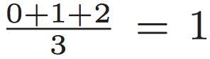
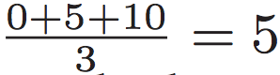
Round Robin
Average response time for RR:
Average response time for SJF:

Slide 66

RR: Is the grass always greener on the other side?
RR does well for response time.
The shorter the time slice, the better it is for RR.

Slide 67
RR: Is the grass always greener on the other side?
RR does well for response time.
The shorter the time slice, the better it is for RR.
But, what about the overhead of a context switch?

Slide 68
RR: Is the grass always greener on the other side?
RR does well for response time.
The shorter the time slice, the better it is for RR.
But, what about the overhead of a context switch?
A context switch is expensive, so we need to be careful here. In other words, shorter time slice means context switch dominates performance.
And, what about turnaround time?

Slide 69
Round Robin: Turnaround
A, B, and C, each with running times of 5 seconds, arrive at the same time, and RR is the scheduler with a (long) 1-second time slice.
We can see from the picture above that A finishes at 13, B at 14, and C at 15, for an average of 14. Pretty awful! (SJF is 10)

Slide 70
Punch Line
More generally, any policy (such as RR) that is fair, i.e., that evenly divides the CPU among active processes on a small time scale, will perform poorly on metrics such as turnaround time.

Slide 71
Punch Line
More generally, any policy (such as RR) that is fair, i.e., that evenly divides the CPU among active processes on a small time scale, will perform poorly on metrics such as turnaround time.
Indeed, this is an inherent trade-off:

Slide 72
Punch Line
More generally, any policy (such as RR) that is fair, i.e., that evenly divides the CPU among active processes on a small time scale, will perform poorly on metrics such as turnaround time.
Indeed, this is an inherent trade-off:
if you are willing to be unfair, you can run shorter jobs to completion, but at the cost of response time.
if you instead value fairness, response time is lowered, but at the cost of turnaround time. This type of trade-off is common in systems
you can’t have your cake and eat it too!

Slide 73

You can’t have your cake and eat it too!
But, is there a way we can have at least half?

Slide 74

The End

